Slide 1
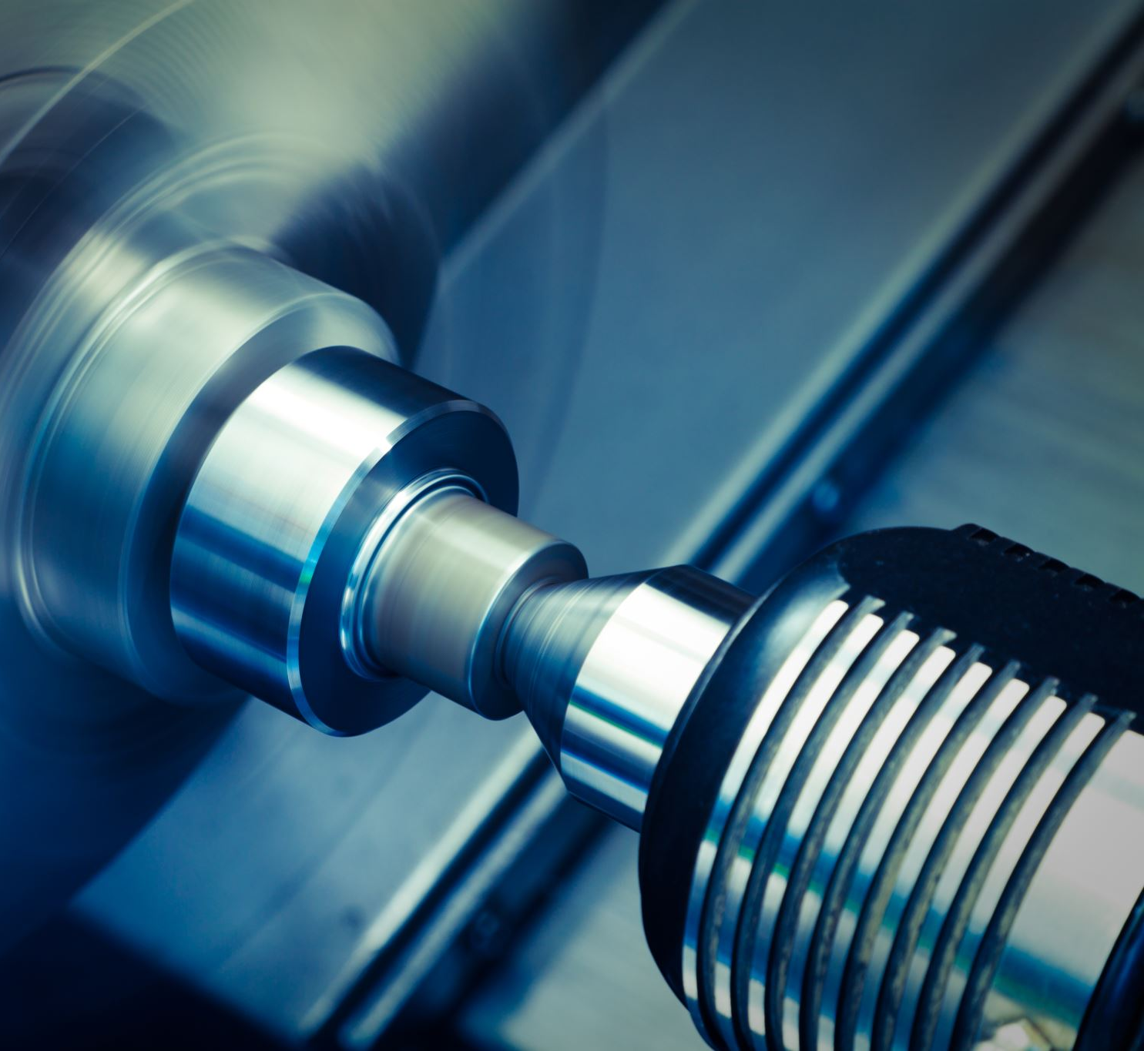
Lathe Machine

Slide 2
Definition:
Lathe is a machine, which removes the metal from a piece of work to the required shape and size
Lathe is one of the most important machine tools in the metal working industry. A lathe operates on the principle of a rotating workpiece and a fixed cutting tool.
The cutting tool is fed into the workpiece, which rotates about its own axis causing the workpiece to be formed to the desired shape
Function of Lathe is to remove excess material in the form of chips by rotating the work piece against a stationary cutting tool

Slide 3
Main Parts of Lathe Machine:
Bed:-Supports all major components
Head Stock:-Holds the jaws for the work piece, supplies power to the jaws and has various drive speeds
Tail Stock:– supports the other end of the workpiece
Carriage:- : slides along the ways and consists of the cross-slide, tool post, apron
Legs :-Support the entire load of the machine

Slide 4
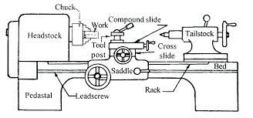

Slide 5
Lathe Operations:
Turning
to remove material from the outside diameter of a workpiece to obtain a finished surface.
Facing
to produce a flat surface at the end of the workpiece or for making face grooves.
Boring
to enlarge a hole or cylindrical cavity made by a previous process or to produce circular internal grooves.
Drilling
to produce a hole on the work piece.
Reaming
to finishing the drilled hole.
Threading
to produce external or internal threads on the work piece.
Knurling
to produce a regularly shaped roughness on the workpiece.

Slide 6
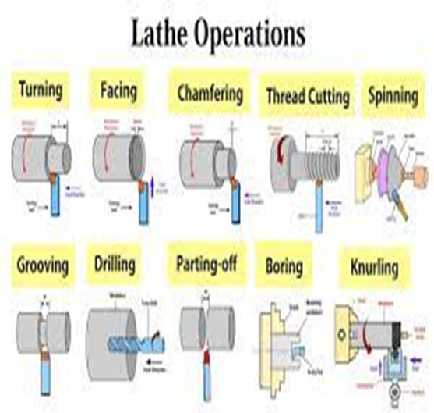
Lathe Machine Operations:

